Slide 1
Accounting for Space using Spatial Econometrics & Network techniques
Rodolfo Metulini (rodolfo.metulini@unibs.it)
University of Brescia - Department of Economics & Management
October 4th, 2016

Slide 2
First of all: Introducing myself
IMT Lucca – LIME unit
Univ. Bologna – Dip. Statistica
S.Anna Pisa – Dep. Economia
Universita di Brescia – Dep. Eco & Mgmt

Slide 3
Topics
International trade (trade, migration, virtual water trade)
Innovation
Sport Statistics
Expertises
Spatial Econometrics & Statistics (mainly applied)
Social Networks (applied)
R
Gravity & Spatial Interaction models

Slide 4
Spatial Econometrics «in a while»

Slide 5
Historical milestones
Moran (1948): Moran I test for spatial autocorrelation
Tobler (1970) first law of Geography: Everything is related to everything else, but near things are more related than distant things
Cliff, Ord (1973,1975,1981): Weight matrices, improvments in spatial autocorrelation tests.
Paelinck , Klaassen (1979): first book on Spatial EconomIcs
Anselin (1988): Spatial autoregressive models and QML estimations
Prucha, Kelejian (1998,1999): Inplemented IV/GMM estimations of Spatial autoregressive models
Jean Paelinck (and his glass of wine)
Ingmar Prucha (left), Yeliz and me talking about spat econ in Vaticano

Slide 6
Spat. Econ. Vs Time Series
Time series literature focuses on the dependence of observations over time and uses the symbol t – 1 to denote variables lagged in time, spat econ is interested in the dependence among observations across space and uses the so called spatial weight matrix W to decribe the spatial arrangement of the geographical units in the sample
Differences:
Geographical units can affect each other, while past affect present but not the other way round (i.e. the present does not affect the past)
Temporal dependence is measured in time, spatial depenence could use a wide variety of units of measurement (neighbors, distance, links, etc…)

Slide 7
(not only) geography matters
Spatial Econometrics is a subfield of econometrics dealing with spatial interaction effets among geographical units.
(units could be zip codes, cities, municipalities, regions, counties, states, countries, and so forth depending on the nature of the study)
Spatial Econometric models can also be used to explain the behaviour of economic agents other than geographical units, if they are related to each other trough networks
(this type of research is less common)
R. Lenders (2002, Social Networks), A.Case (1991, Econometrica), K. Behrens at al. (2012, JoAE), Sgrignoli et al. (2015, Physica A) are examples of empirical works that use a non spatial weight matrix.

Slide 8
The weight matrix W
W is a nxn squared (and possibly symmetric) matrix that define who is neighbours with who.
How to construct the matrix:
1) Contiguity criteria: Rook, Queen, etc…
2) Inverse Distance criteria
3) Similarity in technology criteria
4) Etc etc…
Story by Prof. Anil K. Bera (Illinois) :
Once a time a student went to the pick of the tallest mountain, so, since he was curious, asked to God: «how tall is this mountain?» and God answered: «I don’t know, it is a too much difficult question for me, please ask me another question». «Ok!» said the student: «how should I define the W matrix?”. “Ok, ok” said God “I will tell you how tall is this mountain”
- Even God Doesn’t know.
Anil and me eating «tiramisù» in Rome

Slide 9
Overview of models and methods
Models:
Based on cross sectional data
(Anselin 1988, Cressie 1993, Griffith 1988, Arbia 2006, LeSage & Pace 2009)
2. Based on spatial panel
a. Just pool time series cross sectional data
b. Controlling for fixed/random space/time effects
3. Dynamic spatial panel data models
Methods:
1. Traditional autoregressive models (parametric and linear).
Concentrated Maximum Likelihood (CML)
Generalized Method of Moments (GMM)
Bayesian
2. Generalized (non linear) parametric models
Based on count models (poisson/negbin)
Semi parametric methods
Spatial Filters (SF)
Average Weighted Regression (AWR)

Slide 10
Cross section linear autoregressive models
SAR: $y= ρWy+Xβ+ε$
SEM: $y= Xβ+ γWu+ε$
SAC: $y= ρWy+Xβ+γWu+ε$
SLX: $y=Xβ+WXλ+ε$
DURBIN (SDM): $y= ρWy+Xβ+WXλ+ε$
DURBIN ERROR (SDEM): $y= Xβ+WXλ+ γWu+ε$
MANSKI (GNS): $y= ρWy+Xβ+WXλ+ γWu+ε$

Slide 11
R , STATA, MATLAB packages
STATA: Package SPPACK
David M. Drukker, Hua Peng , Ingmar Prucha, Rafal Raciborski
http://ideas.repec.org/c/boc/bocode/s457245.html
R: Package SPDEP: http://cran.r-project.org/web/packages/spdep/spdep.pdf (Bivand) For cros section
Package SPLM: http://cran.r-project.org/web/packages/splm/splm.pdf (Millo, Piras) For Panel data
MATLAB: http://www.spatial-econometrics.com/ (Routine by Le Sage, Pace)

Slide 12
Macro vs. Micro
MICRO
Both exogenous (location choice of individuals) and endogenous (decision of local authorities in the choosen place) location
Econometric models derived from choices of individual agents
Greater realism, information content, disaggregation, heterogeneity and dynamics, causal inference
MAUP (Modifiable aral unit problem, Arbia 1989) and Ecological fallacy
MACRO
Location is treated as endogenous
Lack of theory supporting macro econometric modelling
Can only lead to the identification of technical relationships (Pinske, Slade, 2010, JoRS)

Slide 13
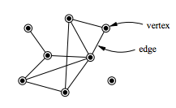
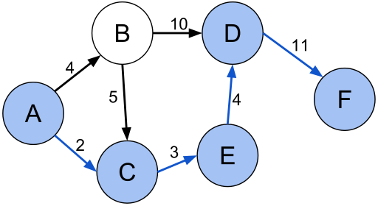
Networks in «more than a while»
Network theory is the study of graphs as a representation of either symmetric or, more generally, of a asymmetric relations between discrete objects.
Network theory is a part of graph theory: a network can be defined as a graph in which nodes and/or edges have attributes (e.g. names).
Social network analysis examines the structure of relationships between social entities. These entities are often persons, but may also be groups, organizations, web sites, or scholarly publications
Information about the relative importance of nodes and edges in a graph is obtained through CENTRALITY measure
SPL (shortest path length) is the path between two nodes in a graph such that the sum of the weights of its constituent edges is minimized
Shortest path between A and F

Slide 14
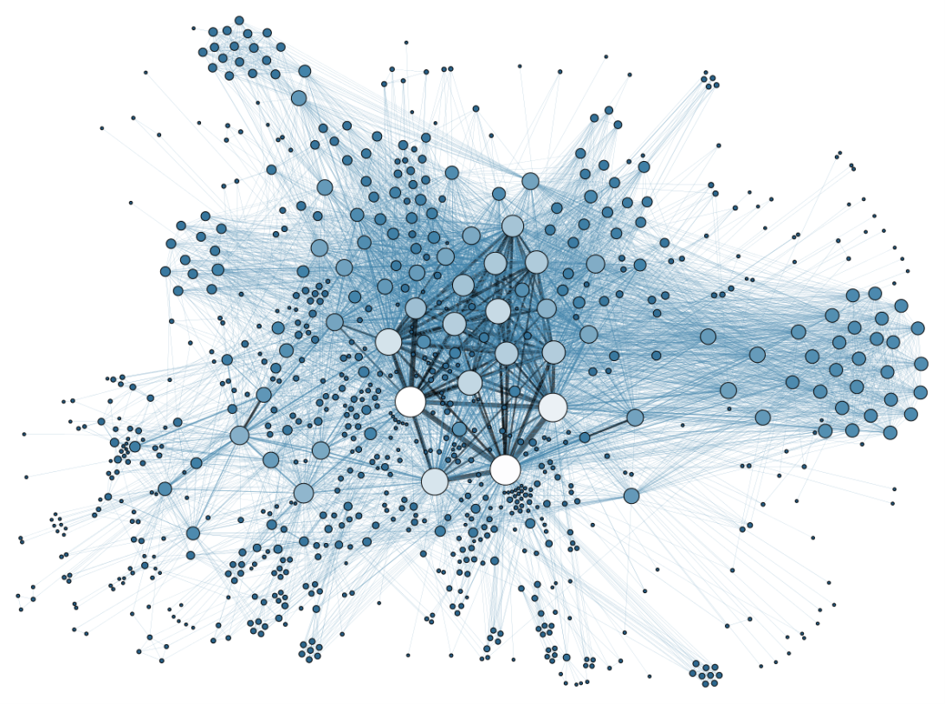
Networks vs. interaction (gravity) models
Descriptive vs. Inferencial approach
Micro vs. Macro
Pair vs. Unit
Spatial vs. Social
Centrality(nodes)and SPL (edges) – (often exogenous) vs. mass and distance (often endogenous)
Network statistics (density, avg. Degree, assortativity) vs. descriptive (mean, median etc…)

Slide 15
Network theory & Spat. Econ (sometimes they meet)
Peer effects through social networks. Mansky Model (C. Mansky, 1993, RoES) and Reflection Problem (identification issues)
Endogenous effect : the influences of peer outcomes Exogenous effects: infl. of peer caracheristics
$y= α+ βE\left(y | x\right)+E{\left(z | x\right)}^{′}γ+z^{′}η+u, E\left(u | x,z\right)=x^{′}δ$ Correlated effect: individuals in the same reference
group tend to behave similarly because they face a common environment.
Y = Outcome; X = Group attributes; Z = individual attributes

Slide 16
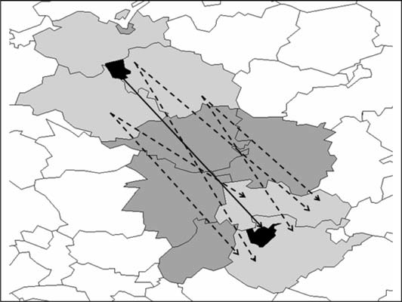
Network theory & Spat. Econ (sometimes they meet)
2) Interaction (or gravity) models with spatial effect (M. Fischer, D. Griffith, 2008, JoRS)
Application to patent citation
Gravity model F_ij = M_i * M_j / D_ij
Linear (GLS), Count (Poisson), logit/Probit
Third country of the origin (W_o), of the destination (W_d), of both (W_od)

Slide 17
to contextualize
The determinants of the editorial board appointment in economics (R. Miniaci, M. Pezzoni):
Biographical characteristics
Scientific productivity
Field of expertise
Social Connections (geo distance, physical proximity)
NEW 1. Group attributes (a weighted average of variables in 1-2-3).
NEW 2. Attributes of the origin (researcher) neighbors and/or attributes of destination (board committe) neighbors.

